Slide 1


PROJECT WORKFLOW OVERVIEW :
Coffee Quality
Data Analysis
PROJECT WORKFLOW OVERVIEW :
1) Data Cleaning
2) Exploratory Data Analysis (EDA)
3) Data Visualization
4) Analysis and Interpretation
5) Documentation
Shreeman DR - Data Analytics
Milestone – 1 (Python Data exploration Project) Date : 10-06-2024

Slide 2

Introduction
The objective of this project is to conduct
a comprehensive data exploration, cleaning, and analysis to derive meaningful insights from the dataset.
Importance of data understanding, preprocessing, and visualization in data analytics projects :
1) Data Understanding:
Contextualization, Identifying Limitations and Feature Selection.
2) Data Preprocessing:
Data Quality, and Normalization and Feature Engineering.
3) Visualization:
Insight Generation, Communication and Decision Making.

Slide 3
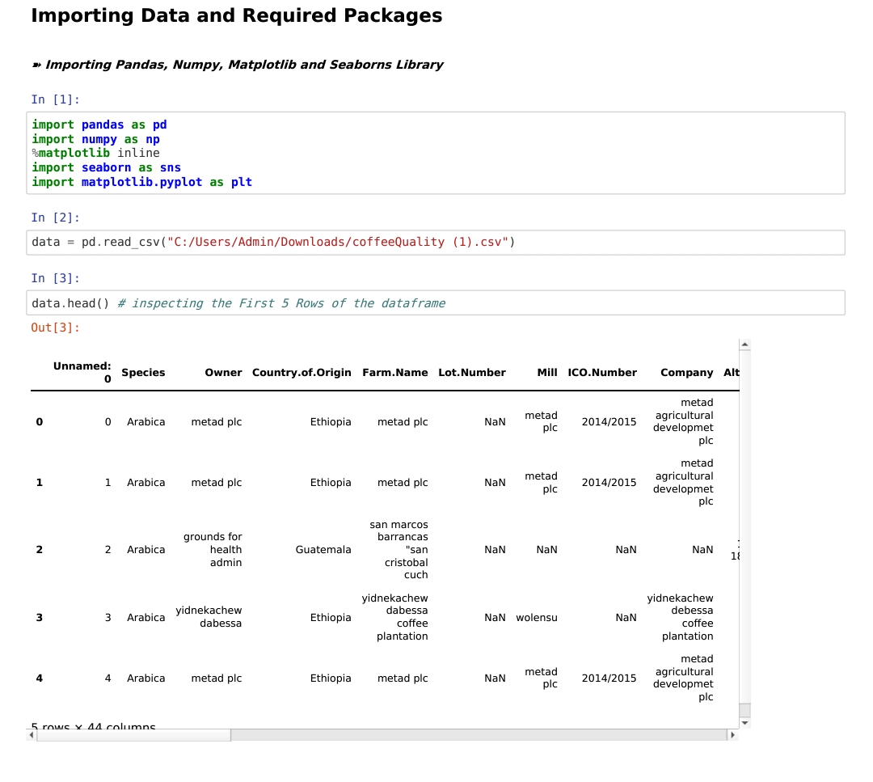
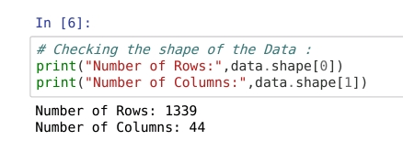

Data Understanding :
• Overview of the dataset structure: number of rows, columns, data types.
• Summary statistics: mean, median, min, max for numerical features.

Slide 4
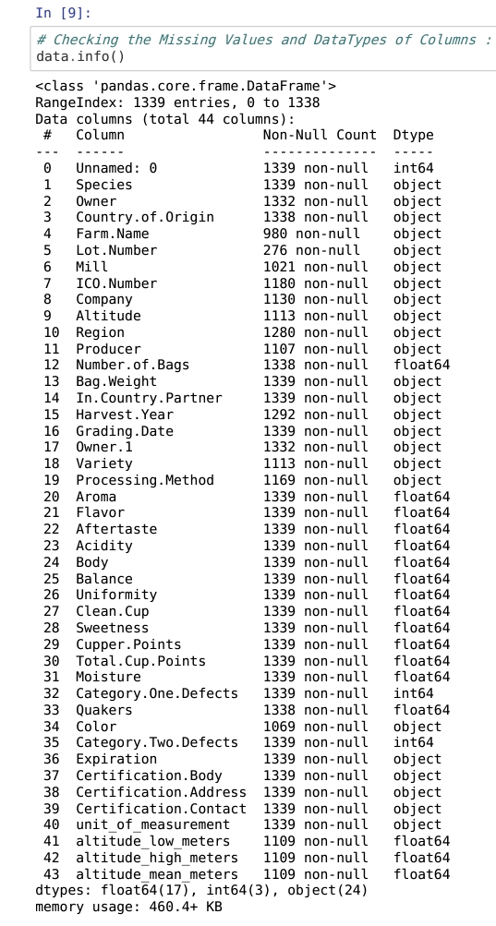
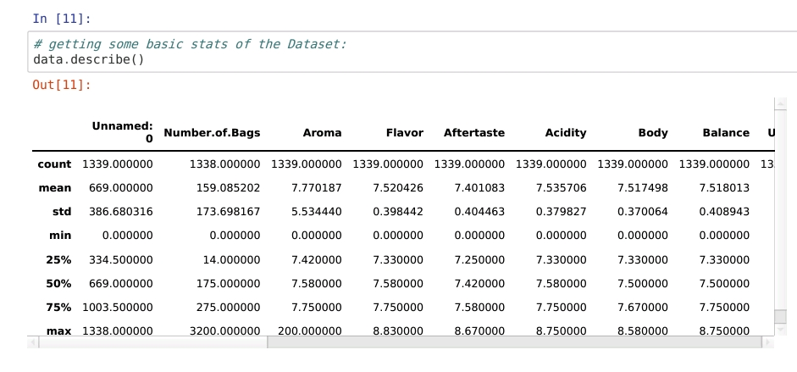
Data Understanding :

Slide 5
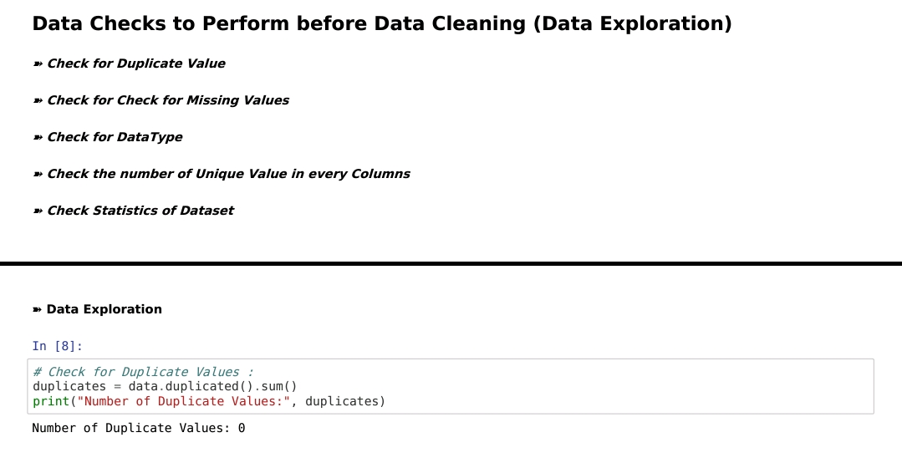
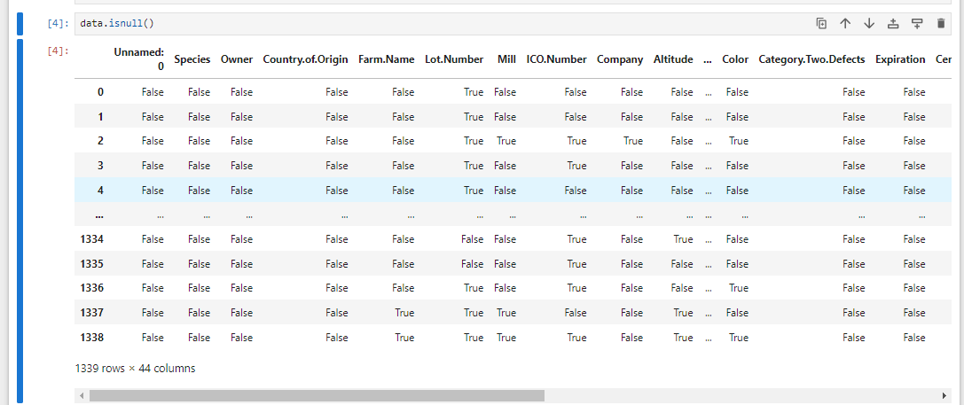
Initial Exploration
• Insights from initial exploration: any notable patterns, outliers, or missing values observed.

Slide 6
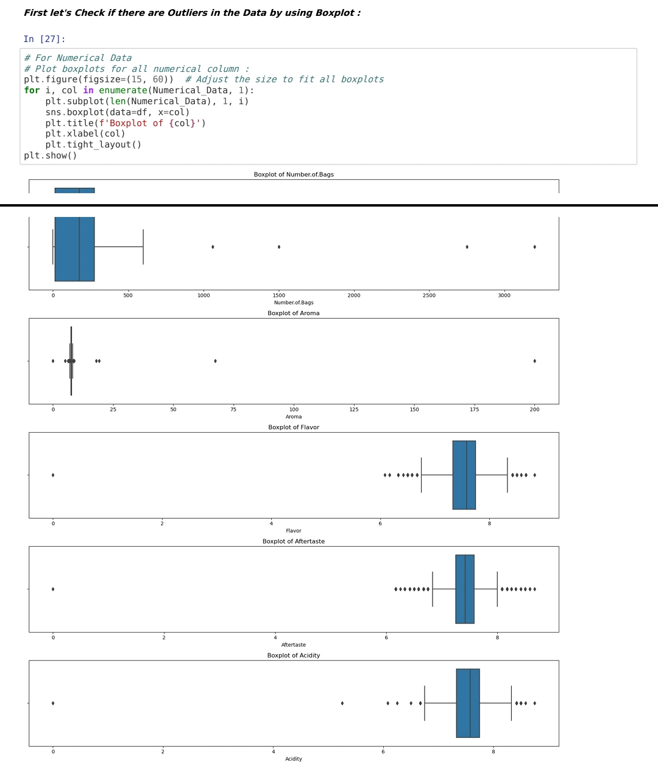
Initial Exploration

Slide 7
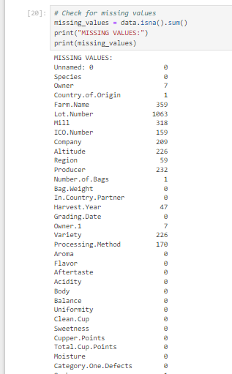
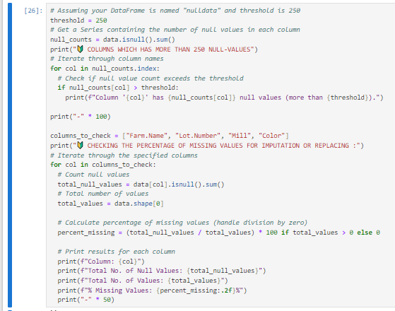
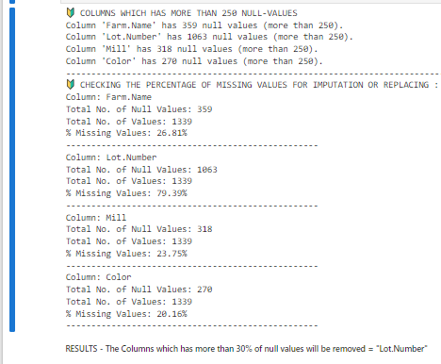
Missing Values Handling
• Techniques used to detect missing values.
• Techniques used to handle missing values (e.g., imputation, deletion).
• Before-and-after comparison: Shape of the dataset

Slide 8
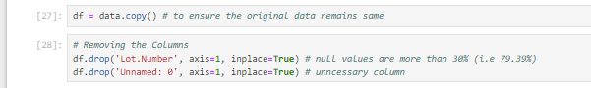
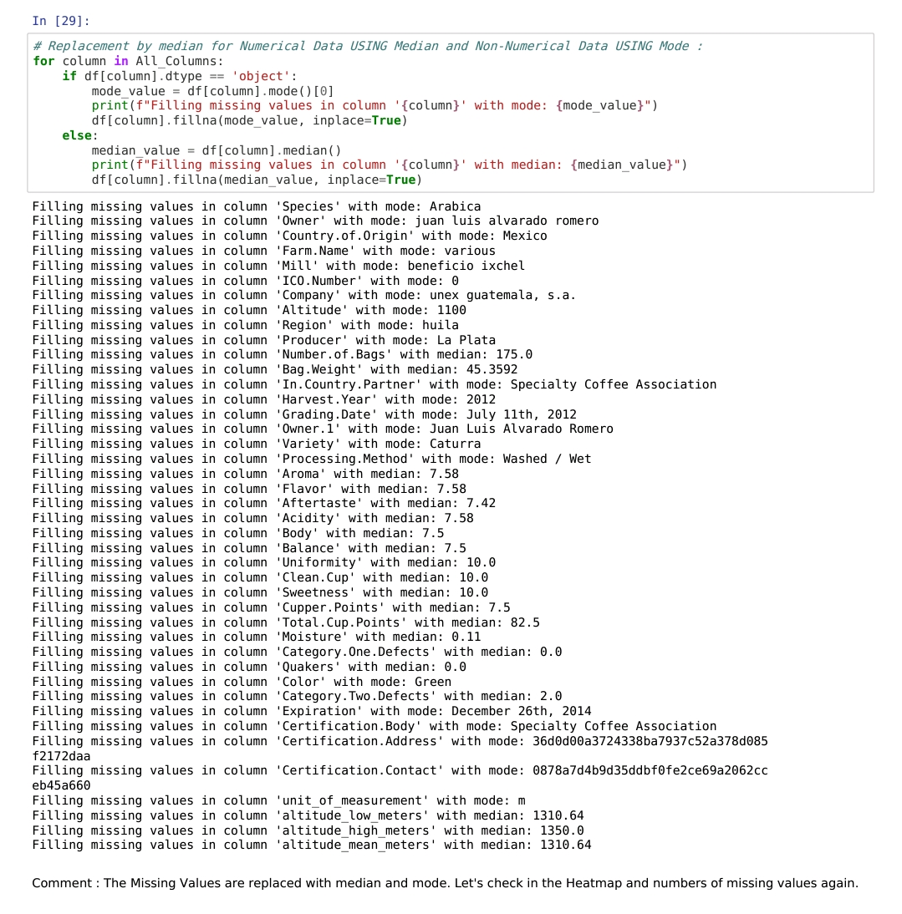
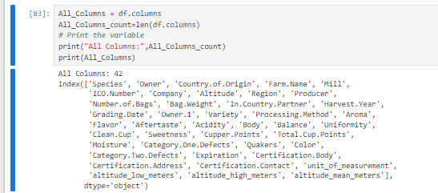
Missing Values Handling

Slide 9
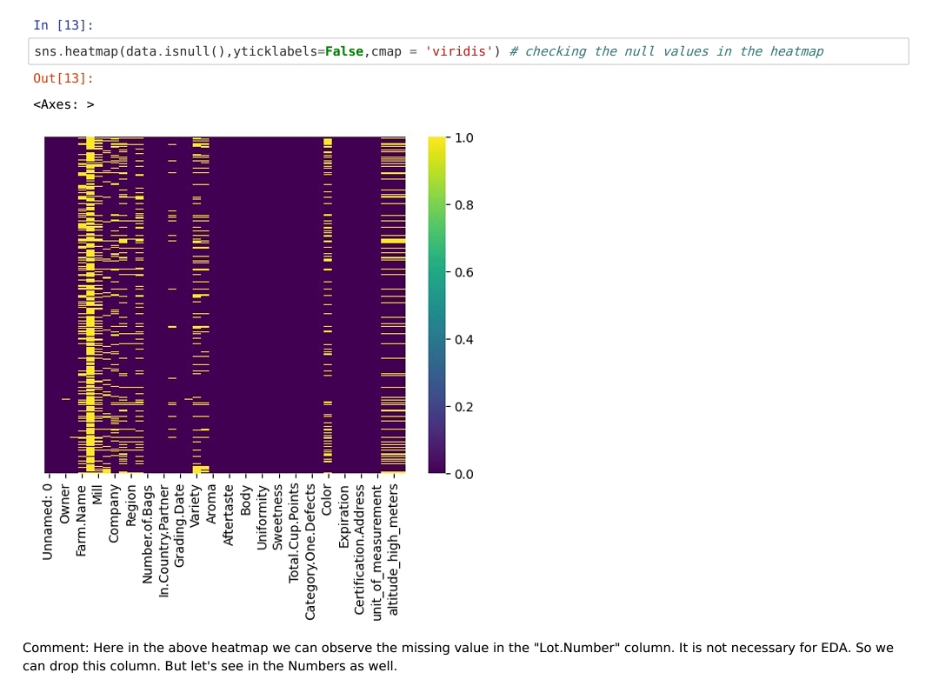
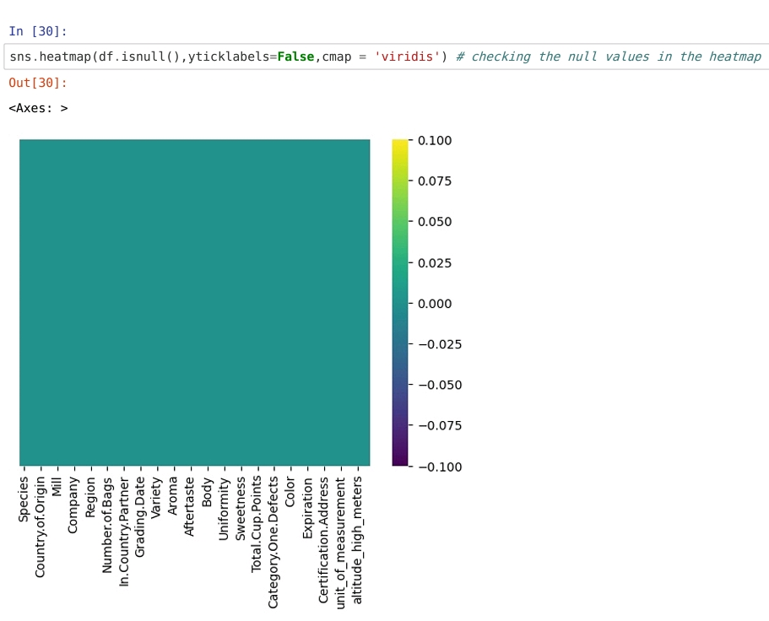
Missing Values Handling

Slide 10
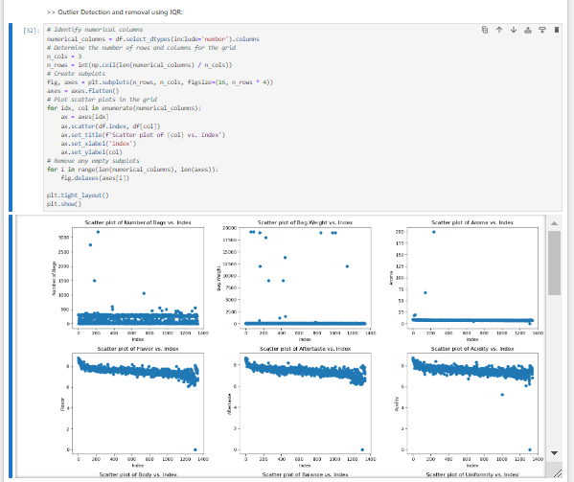
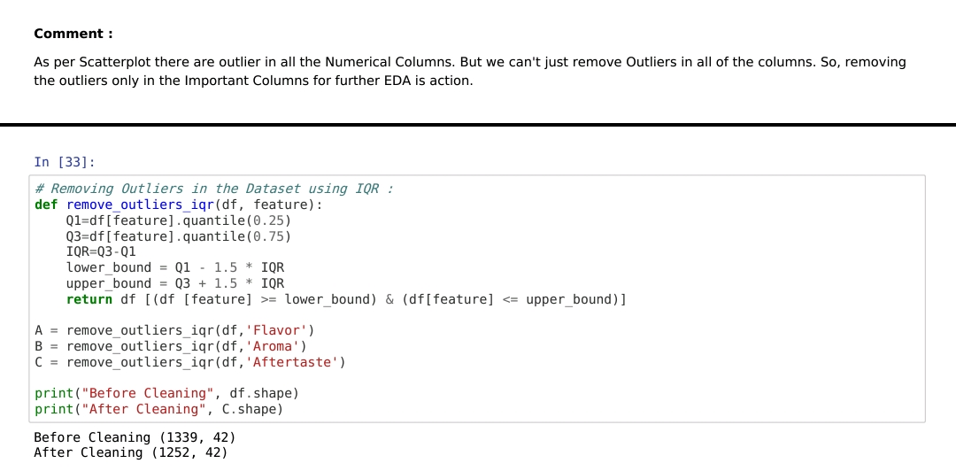
Outlier Detection
• Strategies for identifying and handling outliers (e.g., removal, transformation).
• Box plots or scatter plots to visualize outliers in numerical features.
• Explanation of outlier removal techniques and impact on the dataset

Slide 11
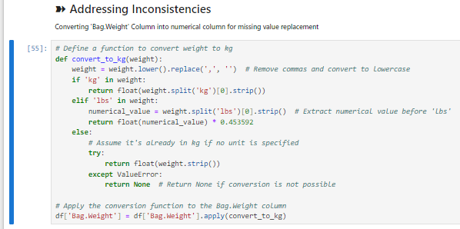
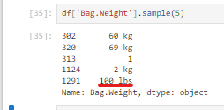
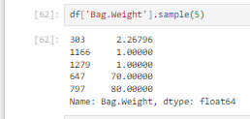
Fixing rows and columns
• Details of fixing rows and columns.
• Before and After Comparison : Shape of the Data

Slide 12
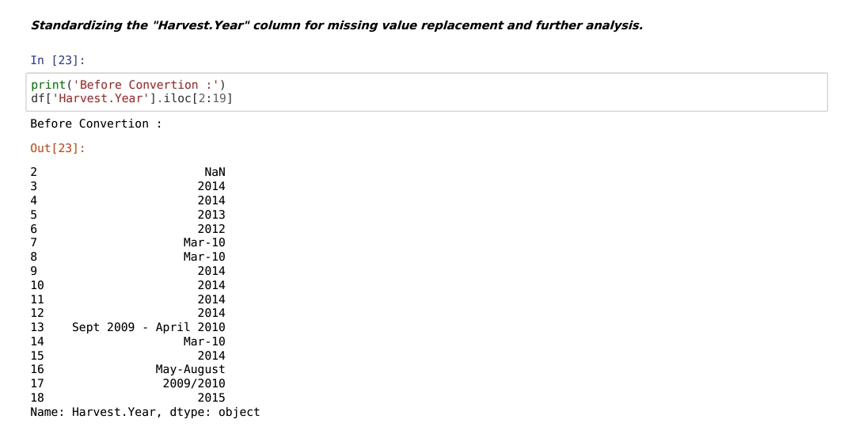
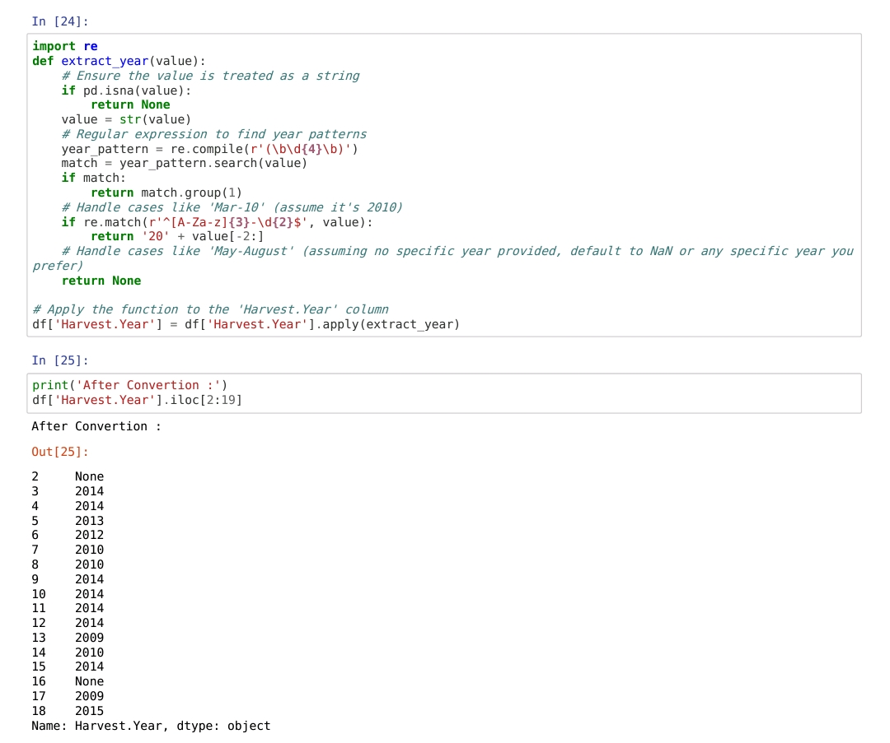
Fixing rows and columns

Slide 13

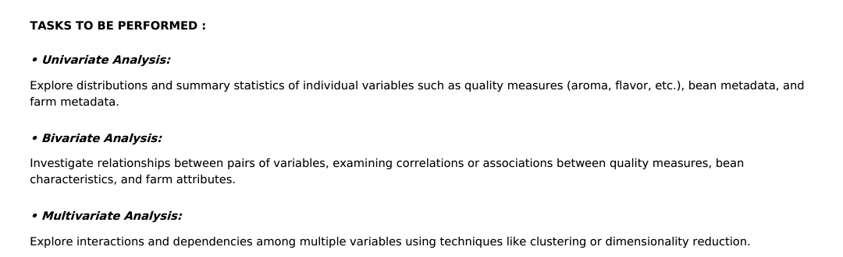
Data Visualization (EDA)
• Overview of exploratory data analysis techniques used.
• Summary of key insights and findings from the visualization process.
• Selection of impactful visualizations from univariate, segmented univariate, bivariate, and
multivariate analysis.
• Graphs: Include representative visualizations such as histograms, bar charts, scatter plots,
and heatmaps showcasing key analysis results.

Slide 15


Conclusion: Unlocking the Potential of the Coffee Quality Database
1
Comprehensive Data Insights
2
Driving Innovation and Improvement
3
Fostering Collaboration and Transformation
The comprehensive exploration of the Coffee Quality Database has revealed a wealth of insights, spanning quality measures, bean characteristics, and farm-level attributes. These findings offer valuable guidance to coffee industry stakeholders, empowering them to make informed decisions and optimize their operations.
By uncovering key trends, recognizing outliers, and providing actionable recommendations, the analysis of the Coffee Quality Database serves as a catalyst for innovation and continuous improvement in the coffee industry. These insights can inspire new production methods, bean selection strategies, and farming practices to enhance the overall quality of coffee worldwide.
The thorough documentation and audience-centric presentation of the analysis report will serve as a valuable resource for coffee professionals, researchers, and enthusiasts alike. By sharing these insights and fostering collaboration, the Coffee Quality Database can become a driving force behind the transformation and advancement of the coffee industry.

